Slide 1

Determining Costs, Budget and Earned Value

Slide 2
Chapter Concepts
Estimating the costs of activities
Determining a time-phased baseline budget
Determining the earned value of the work performed
Analysing cost performance
Forecasting project cost at completion
Controlling project costs
Managing cash flow

Slide 3
Learning Outcomes
Estimate the cost of activities
Aggregate the total budgeted cost
Develop a time-phased baseline budget
Describe how to accumulate actual costs
Determine the earned value of work performed
Calculate and analyse key project performance measures
Discuss and apply approaches to control the project budget
Explain the importance of managing cash flow

Slide 4
Project Cost Management
Project Management Knowledge Areas from PMBOK® Guide

Slide 5
Estimate Activity Costs
Elements
Good practices
Labour
Materials
Equipment
Facilities
Subcontractors and consultants
Travel
Reserve
Have the person responsible estimate costs
Use historical data to inform current project
Be reasonable and realistic
Estimate near-term activities more accurately
Elaborate other costs as additional information known

Slide 6
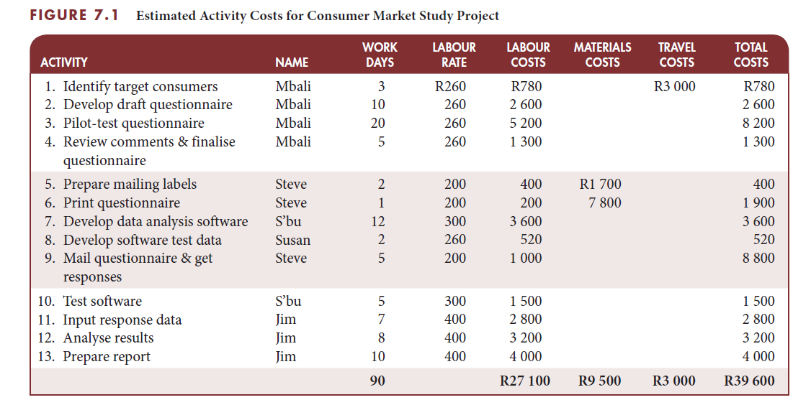
Consumer market study project estimated costs

Slide 7
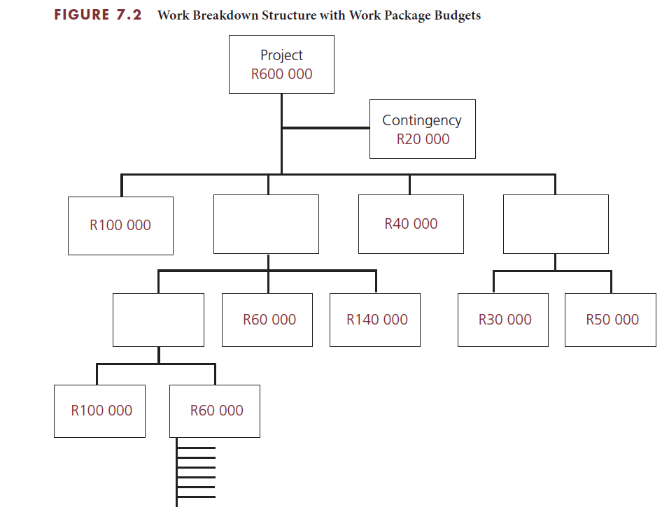
Aggregate total budgeted cost
Establish a TBC for each work package
Determine the process
Top-down
Bottom-up
If sum of initial estimates exceeds sponsor budget, then reduce costs and recalculate

Slide 8
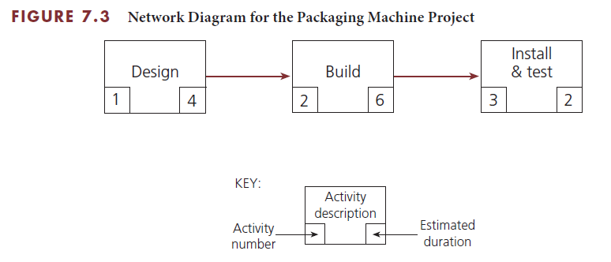
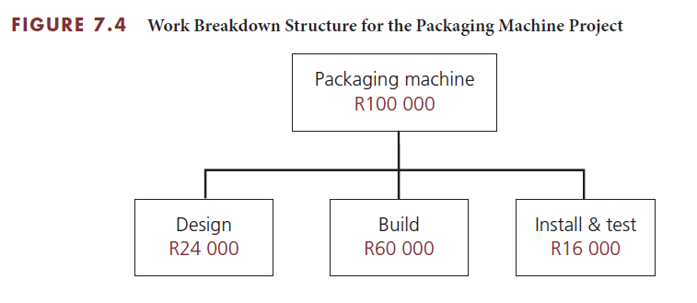
Packaging machine project aggregate total budgeted cost

Slide 9
Develop cumulative budgeted cost
Distribute each total budgeted cost (TBC) over work package duration
Create the time-phased budget
Calculate cumulative budgeted cost
Provides a baseline against which actual cost and work performance are measured

Slide 10
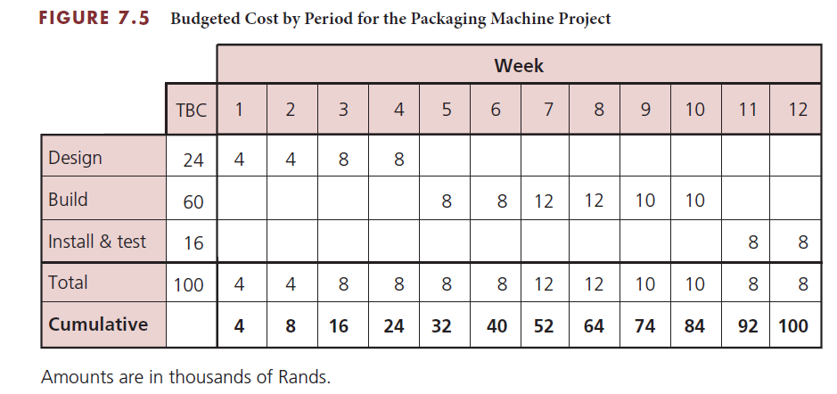
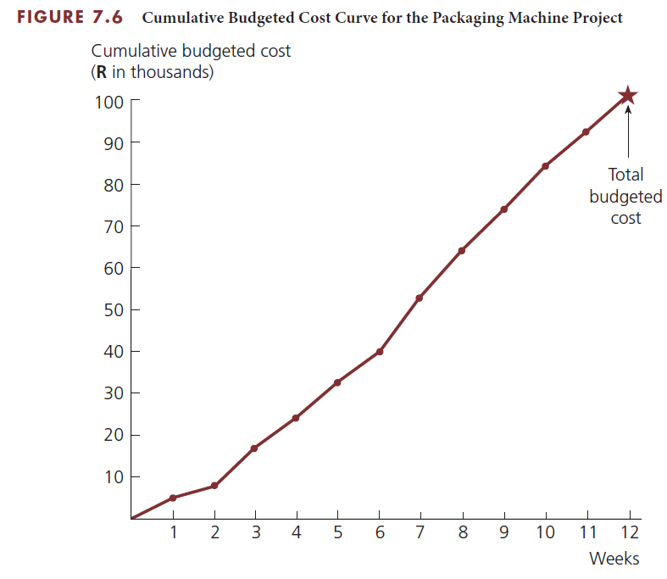
Packaging machine project develop cumulative budgeted cost
Determine budgeted cost by period
Graph the cumulative budgeted cost curve

Slide 11
Determine Actual Cost
Actual cost
Collect data regularly for funds actually expended
Charge to work package numbers
Committed costs
Periodically assign portion of total cost to actual cost
Include costs for items that will be paid for later
Compare actual cost to budgeted cost
Calculate cumulative actual cost
Compare to cumulative budgeted cost

Slide 12
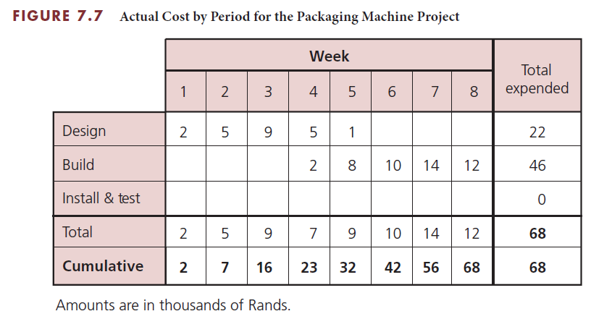
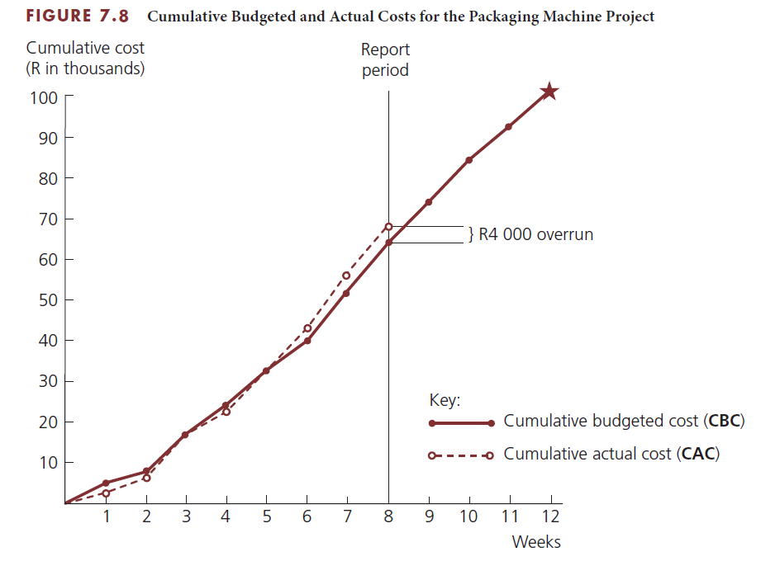
Packaging machine project determine actual cost
End of Week 8
Planned cost = R64,000
Actual cost = R68,000
Compare CAC with CBC

Slide 13
Determine Value of Work Performed
Example project
At Day 5
Paint 10 similar rooms
Total budgeted cost of R2 000
Budget is R200 per room
R1 000 has been spent
3 rooms have been painted
Earned value =
0.30 X R2 000 = R600
Have expended R400 more than the earned value

Slide 14
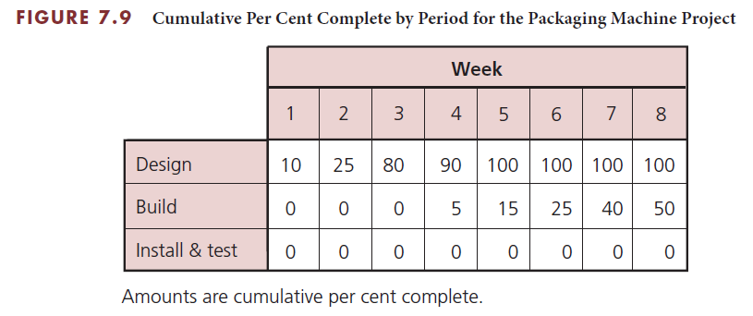
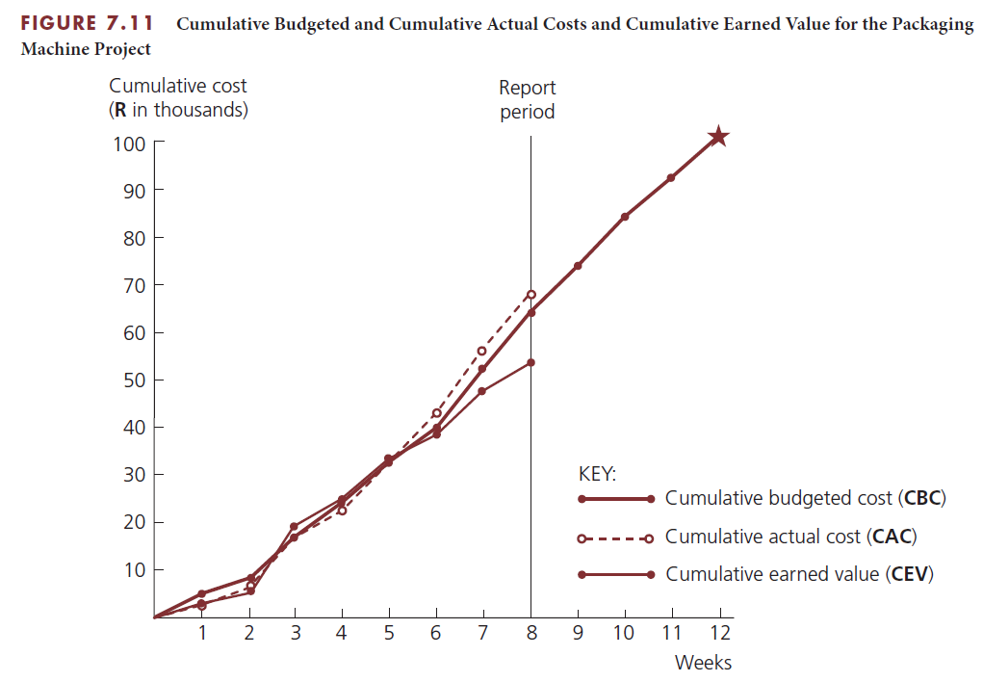
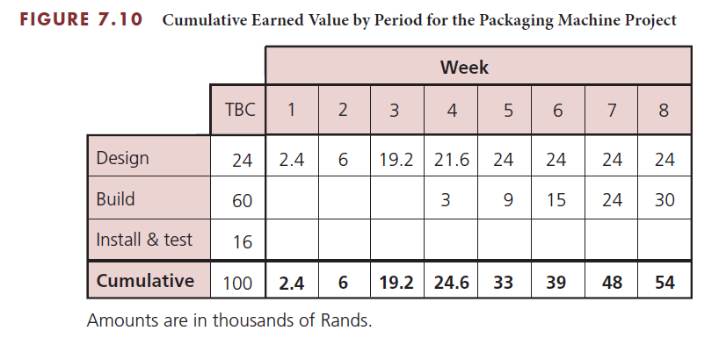
Packaging machine project determine value of work performed

Slide 15
Analyse Cost Performance
Four cost-related measures
TBC – total budgeted cost
CBC – cumulative budgeted cost
CAC – cumulative actual cost
CEV – cumulative earned value
Use to analyse project cost performance
Plot CBC, CAC, and CEV curves on the same graph
Reveal any trends toward improving or deteriorating cost performance

Slide 16
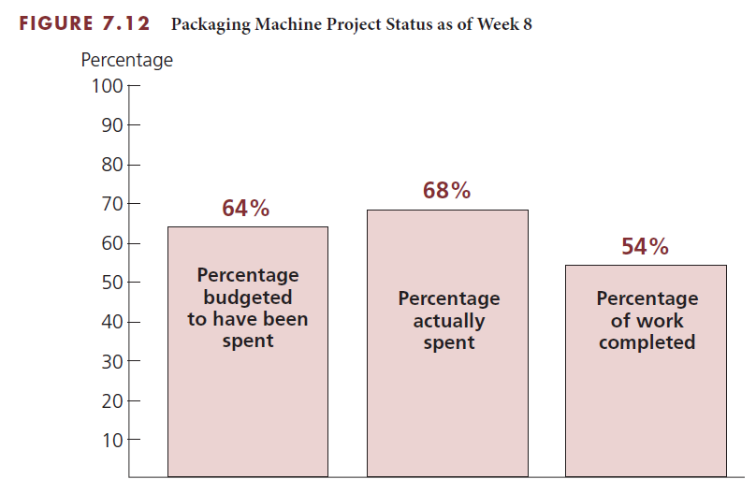
Packaging machine project analyse cost performance

Slide 17
Cost performance index
Measure of the cost efficiency with which the project is being performed
Cost performance index =
Cumulative earned value/Cumulative actual cost
CPI = CEV/CAC

Slide 18
Packaging machine project cost performance index
End of Week 8
Determine CPI
R64 000 was budgeted
R68 000 was actually expended
R54 000 was the earned value of work actually performed
CEV = R54 000
CAC = R68 000
CPI = CEV/CAC
= R54 000/R68 000
= 0.79
For every R1.00 actually expended, only R0.79 of earned value was received.

Slide 19
Cost variance
Indicator of cost performance
Difference between the cumulative earned value of the work performed and the cumulative actual cost
Cost variance =
Cumulative earned value – Cumulative actual cost
CV = CEV – CAC

Slide 20
Packaging machine project cost variance
End of Week 8
Determine CV
R64 000 was budgeted
R68 000 was actually expended
R54 000 was the earned value of work actually performed
CEV = R54 000
CAC = R68 000
CV = CEV – CAC
= R54 000 – R68 000
= –R14 000
The value of the work performed through week 8 is R14 000 less than the amount actually expended.

Slide 21
Schedule performance index
Measure of the schedule efficiency with which the project is being performed
Schedule performance index =
Cumulative earned value/Cumulative budgeted cost
SPI = CEV/CBC

Slide 22
Packaging machine project cost performance index
End of Week 8
Determine CPI
R64 000 was budgeted
R68 000 was actually expended
R54 000 was the earned value of work actually performed
CEV = R54 000
CBC = R64 000
SPI = CEV/CBC
= R54 000/R64 000
= 0.84
For every R1.00 that should have been completed, only R0.84 of earned value was completed.

Slide 23
Schedule variance
Indicator of schedule performance
Difference between the cumulative earned value of the work performed and the cumulative budgeted cost
Schedule variance =
Cumulative earned value – Cumulative budgeted cost
SV = CEV – CBC

Slide 24
Packaging machine project cost variance
End of Week 8
Determine CV
R64 000 was budgeted
R68 000 was actually expended
R54 000 was the earned value of work actually performed
CEV = R54 000
CBC = R64 000
CV = CEV – CBC
= R54 000 – R64 000
= –R10 000
The value of the work performed through week 8 is R10 000 less than the amount actually budgeted.

Slide 25
Estimate Cost at Completion
Forecast what the total costs will be at the completion of the project or work package
3 different methods
FCAC = TBC/CPI
FCAC = CAC + (TBC – CEV)
FCAC = CAC + Re-estimate of remaining work
Another method
TCPI = (TBC – CEV)/(TBC – CAC)

Slide 26
Packaging machine project estimate cost at completion
End of Week 8
Determine FCAC
R64 000 was budgeted
R68 000 was actually expended
R54 000 was the earned value of work actually performed
CEV = R54 000
CAC = R68 000
CPI = 0.79
TBC = R100 000
FCAC = TBC / CPI
= R100 000/0.79 = R126 582
FCAC = CAC + (TBC – CEV)
= R68 000 + (R100 000 – R54 000)
= R68 000 + R46 000
= R114 000
TCPI = (TBC – CEV)/(TBC – CAC)
= (R100 000 − R54 000)/(R100 000 − R68 000)
= R46 000/R32 000
= 1.44

Slide 27
Control Costs
Analyse cost performance on a regular basis
Determine which work packages require corrective action
Decide what specific corrective action
Revise the project plan
Evaluate negative cost variance
Take corrective actions
Near term activities
Activities with large cost estimate
Reduce costs of activities
Evaluate the trade-off of cost and scope

Slide 28
Manage Cash Flow
Ensure that cash comes in faster than it goes out
Negotiate payment terms
Provide a down payment
Make equal monthly payments
Provide frequent payments
Avoid only one payment at end of project
Control outflow of cash

Slide 29
Cost Estimating for Information Systems Development
Common errors in estimating costs
Underestimating the work time necessary to complete an activity
Requiring rework to meet the user requirements
Underestimating growth in the project scope
Not anticipating new hardware purchases
Making corrections to flaws in excess of the reserve planning
Changing the design strategy
Increasing resources to fast-track phases of the SDLC

Slide 30
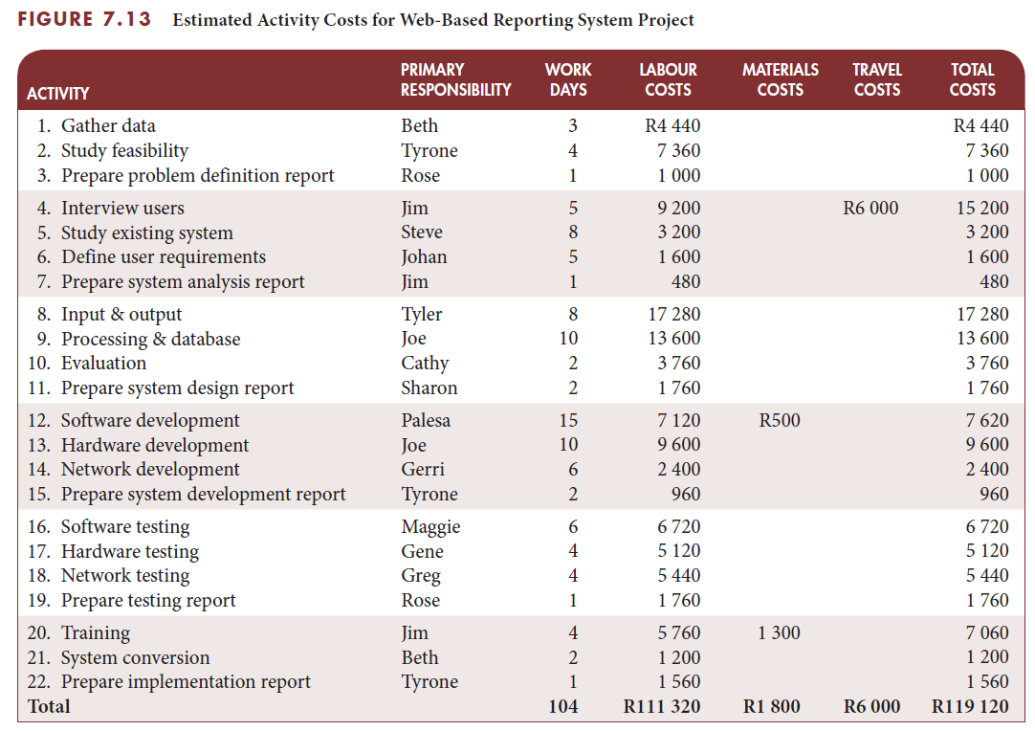
IS example: estimated activity costs

Slide 31
Project Management Information Systems
Store all costs associated with each resource
Calculate the budget for each work package
Determine cost for the entire projects
Define different rate structures for each resource
Analyse cost performance

Slide 32
Critical Success Factors
Estimated activity costs must be based on the estimated activity resources.
The person who will be responsible for performing the activity should estimate the costs for that activity. This generates commitment from the person.
Cost estimates should be reasonable and realistic.
Once the project starts, it is important to monitor actual costs and work performance to ensure that everything is within budget.
A system should be established to collect, on a regular and timely basis, data on costs actually expended and committed, and the earned value (percent complete) of the work performed, so they can be compared to the cumulative budgeted cost (CBC).
If at any time during the project it is determined that the project is overrunning the budget, or the value of the work performed is not keeping up with the actual amount of costs expended, corrective action must be taken immediately.

Slide 33
Critical Success Factors (continued)
It is important to use the time-phased cumulative budgeted cost (CBC), rather than the total budgeted cost (TBC), as the baseline against which cumulative actual cost (CAC) is compared. It would be misleading to compare the actual costs expended to the total budgeted cost because cost performance will always look good as long as actual costs are below the TBC.
To permit a realistic comparison of cumulative actual cost to cumulative budgeted cost, portions of the committed costs should be assigned to actual costs while the associated work is in progress.
The earned value of the work actually performed is a key parameter that must be determined and reported throughout the project.
For each reporting period, the percent complete data should be obtained from the person responsible for the work. It is important that the person make an honest assessment of the work performed relative to the entire work scope.
One way to prevent inflated percent complete estimates is to keep the work packages or activities small in terms of scope and duration. It is important that the person estimating the percent complete assess not only how much work has been performed but also what work remains to be done.

Slide 34
Critical Success Factors (continued)
The key to effective cost control is to analyse cost performance on a timely and regular basis. Early identification of cost variances (CV) allows corrective actions to be taken immediately, before the situation gets worse.
For analysing cost performance, it is important that all the data collected be as current as possible and be based on the same reporting period.
Trends in the cost performance index (CPI) should be monitored carefully. If the CPI goes below 1.0 or gradually decreases, corrective action should be taken.
As part of the regular cost performance analysis, the estimated or forecasted cost at completion (FCAC) should be calculated.
The key to effective cost control is to aggressively address work packages or activities with negative cost variances and cost inefficiencies as soon as they are identified. A concentrated effort must be applied to these areas. The amount of negative cost variance should determine the priority for applying these concentrated efforts.

Slide 35
Critical Success Factors (continued)
When attempting to reduce negative cost variances, focus on activities that will be performed in the near term and on activities that have large estimated costs.
Addressing cost problems early will minimise the negative impact on scope and schedule. Once costs get out of control, getting back within budget becomes more difficult and is likely to require reducing the project scope or quality, or extending the project schedule.
The key to managing cash flow is to ensure that cash comes in faster than it goes out.
It is desirable to receive payments (cash inflow) from the customer as early as possible, and to delay making payments (cash outflow) to suppliers or subcontractors as long as possible.

Slide 36
Summary
The total project cost is often estimated during the initiating phase of the project when the project charter or a proposal is prepared, but detailed plans are not usually prepared at that time.
The project budgeting process involves two steps: the budget for each work package is determined and the budget for each work package is then distributed over the expected time.
Aggregating the estimated costs of the specific activities for the appropriate work packages in the work breakdown structure will establish a total budgeted cost (TBC).
The cumulative budgeted cost (CBC) is the time-phased baseline budget that will be used to analyse the cost performance of the project.
At any time during the project, it is possible to forecast what the total costs will be at the completion of the project or work package based on analysis of actual cost expended and the earned value of work performed.
The key to effective cost control is to analyse cost performance on a regular and timely basis.
It is important to manage the cash flow on a project.

